Slide 1
Title: An introduction to ethics
1. Complete the baseline quiz
2. List five things you think are morally good
3. Explain why the things are morally good.

Slide 2
This is a new topic about ethics!
At the end of this topic you will produce a presentation on an ethical issue of your choice.

Slide 3
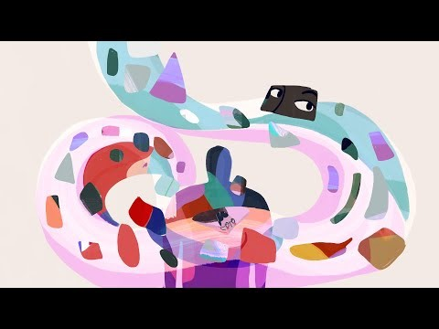
In this topic we are going to be studying: Ethics
The English word ethics is derived from the Ancient Greek word ēthikós (ἠθικός), meaning "relating to one's character", which itself comes from the root word êthos (ἦθος) meaning "character, moral nature"
What might this video suggest about the study of ethics?

Slide 4
List all the different things that influence how you think ethically
Now imagine it is 10 years in the future. Do you think the order would be the same? What would change?
Why might these things influence you?
Now rank what you have listed from those things that influence you the most to the least. Why?
Why might this list be similar for some people and different for others?
Notes:
Discussion questions

Slide 5
How should humans treat non-human life?
Often ethicists ask ethical questions. These ethical questions often contain further ethical questions/issues within them.
On your A3 sheet you have one example of an ethical question related to the ethical issue. Can you think of any more?

Slide 6
What do you think?
I want you to focus on your own lens.
On your sheet: consider not just what you think, but the reasons for your view.
Also, has your view changed? And why
Any exceptions (think about what is meant by the term ‘non-human life’

Slide 7
What does your partner think?
On your sheet. Consider not just what your partner thinks, but the reasons for their view.
Also, has their view changed? And why
Any exceptions (think about what is meant by the term ‘non-human life’.
In the arrows on your sheet – what are the links between your view and your partner’s view. What do you agree on what do you disagree on?

Slide 8
Read about Donna Haraway
What does Haraway argue and why does she argue this view?
Donna Haraway was born on September 6, 1944, in Denver, Colorado. She completed her Ph.D. in biology at Yale in 1972 writing a dissertation about the use of metaphor in shaping experiments in experimental biology and the then trained in philosophy.
In 2003, Haraway published a book called The Companion Species Manifesto: Dogs, People, and Significant Otherness. This book is interesting because it draws on evolutionary biology, philosophy and Haraway’s own experience as a dog owner. Haraway argues that human ‘companion’ relationship with dogs can show humans the importance of recognising and engaging with ‘significant otherness’. What Haraway means by this is that the relationship between humans and dogs can show people how to interact with other humans and non-humans. What we can learn is that humans and dogs are dependent on one another and have a clear emotional bond between them. What Haraway calls ‘Partners in the crime of human evolution’. Therefore, humans should not necessarily see themselves as superior to other animals because we are dependent on them as they are on us.
Notes:
This can be projected or printed.

Slide 9
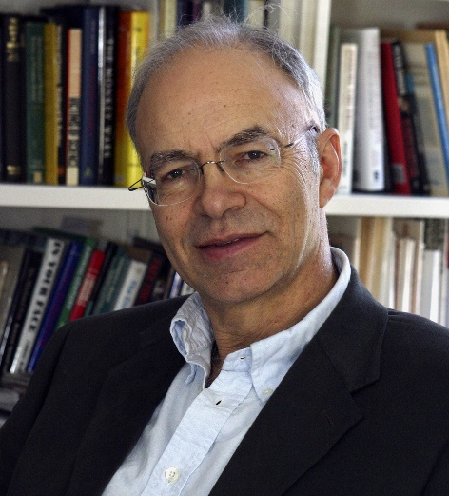
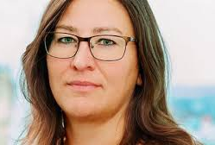
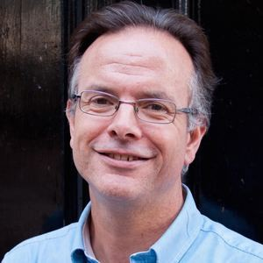
On your tables you have three contemporary ethicists:
Choose and read about one of ethicists on your table and complete your A3 sheet.
Focus on why they argue the view the view they do. What ‘lens’ do they use?
Peter Singer
Soumaya Pernilla Ouis
David Clough
In a different colour pen. On the arrows on your sheet, write the links between the ethicists you have looked at.
Notes:
Use case studies – two of each ethicists per table.

Slide 10
From reading about all these ethicists, what do you learn about ethics?
Notes:
Use case studies – two of each ethicists per table.

Slide 11
Your view is
I think this because
My partner’s view is
The reasons they give for their view are:
Ethical questions within the ethical issue
What do we mean by non human life?
The ethical issue:
How should humans treat non-human life?
_________argues
They argue this by
Donna Haraway argues
They argue this by
Li
Notes:
Print A3

